Slide 1
Surveon Enterprise Solution
with Milestone Introduction
Sales & Marketing Department

Slide 2


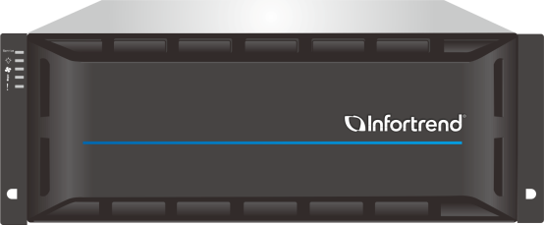
Content
Surveon Enterprise Solution
Product Overview
Feature Highlights
Sales Tips

Slide 3
Surveon Enterprise Solution

Slide 4
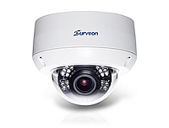
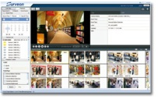
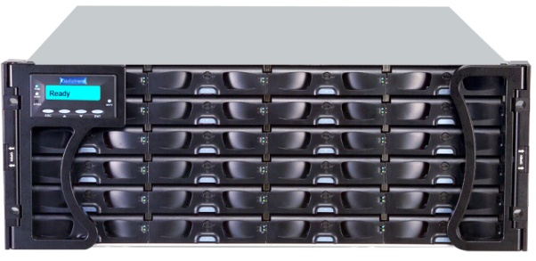


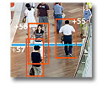
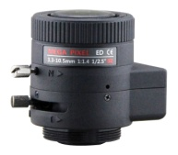
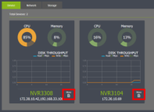
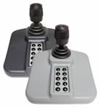
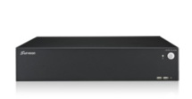
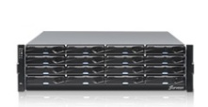

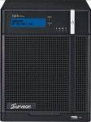
End-to-End Surveillance Solution
Network Camera
ONVIF Cameras
IP Video Storage
Infortrend IP Video Storage
Video Management
Video Manage- ment Software (VMS)
Surveon Control Center (CMS)
Video Analytics
SurveOne – Real-time System Monitoring Tool
Accessories
Lens
Peripheral
Bracket
Network Video Recorder
Rackmount NVR
Tower NVR Series

Slide 5
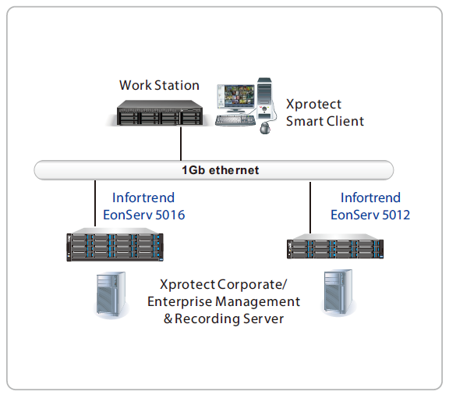
Solution Topology with Milestone XProtect
  Infortrend EonServ 5012/5016 NVR with pre-loaded Milestone XProtect VMS
  Excellent performance on supporting 150 CH 3M cameras with continuous recording
  Easily expand number of retention days with up to 316 drives with high density 4U 60-bay expansion enclosure (maximum capacity of up to 2.5 PB with 8TB HDD)

Slide 6
Product Overview

Slide 7
Market Position
  Target User/Scenario
  Server-storage hybrid design to lower maintenance efforts on project sites
  Pre-loaded Milestone XProtect VMS for specific project needs
  High reliability cableless design for easy maintenance
  Management demand up to 150 channels
  Higher storage expansion for extended data retention
Enterprise-level NVR with the Most Ideal Cost/Performance ratio for Advanced Surveillance

Slide 8
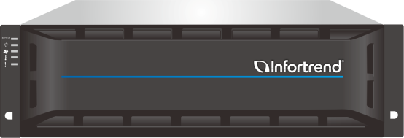
Key Feature
Supports up to 150-channel 3MP cameras with continuous recording
Pre-installed Milestone XProtect VMS
Server-storage hybrid design
Built-in RAID function for data protection
Virtual PCIe channel for RAID F/W and server OS seamless integration
Cableless design with hot swappable redundant component
Built-in SAS expansion for JBODs with up to 316 HDDs
Built-in user-friendly GUI – EonOneLite for viewing the status and event notifications
Intuitive set-up page for hassle-free installation
Notification mechanism
EonServ 5012 / 5016 NVR

Slide 9
EonServ 5000 Series Specifications
Form factor | 2U 12-bay / 3U 16-bay
Controller architecture | Single controller
System drive | Support two 2.5” SATA HDDs (Optional for system drive) ．Install two 2.5” SATA HDDs with RAID1
CPU | Default: Intel Core i3-4330, dual-core 3.5G
 | Upgradable: Intel Xeon E3-1225, quad-core 3.2G
 | Intel Xeon E3-1275, quad-core 3.5G
DIMM slot | DDR3 slot x 4
Memory capacity | Supports up to 32GB (4 x 8GB) with ECC or non ECC
Rear I/O ports | RJ-45 Gigabit Ethernet x2 (default), up to 4 x GbE port (optional)
 | USB 2.0 x 2
 | USB 3.0 x2
 | VGA x 1
 | HDMI x 2
 | Mic. In port x1
 | Speaker out port x 1
Service port | Service port x 1 (mini USB connector – RS 232 interface)
PCI-E Gen3 slot | PCI-E 3.0 x 8 slot x 1
 | Support 10Gbe x2 (SFP+&RJ-45) or 1GbE x 4
Drive interface | 6Gb/s SAS
JBOD expansion | 6Gb/s SAS wide port x 1
Disk support | 3.5” 7,200 RPM NL-SAS 6Gb/s HDD
 | 3.5” 7,200 RPM SATA 3Gb/s and 6Gb/s HDD
Max. disk support number | EonServ 5012
 | 312 disks (1 x EonServ 5012 + 5 x 4U 60-bay JBOD)
 | 180 disks (1 x EonServ 5012 + 14 x 2U 12-bay JBOD)
 | EonServ 5016
 | 316 disk (1 x EonServ 5016 + 5 x 4U 60-bay JBOD)
 | 240 disk (1 x EonServ 5016+ 14 x 3U 16-bay JBOD)
Compatible operation system | Windows Server 2012, 64-bit
 | Windows 7 Professional SP1, 64-bit
Installation | OS can be installed in backend 2.5” SATA system drive
RAID Functionality | RAID 0, 1, 5, 6, 10, 50, 60
PSU | Dual Redundant PSU
Enclosure Dimension | 2U 19-inch rack mount, 3U 19-inch rack mount

Slide 10
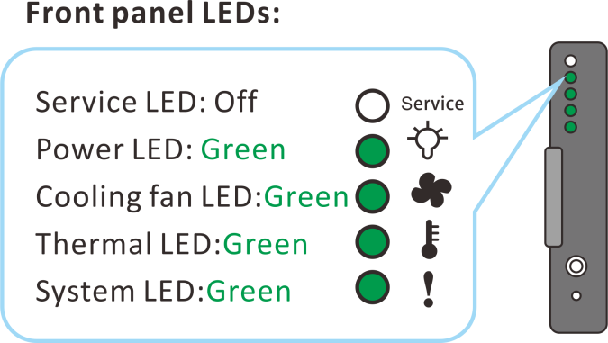
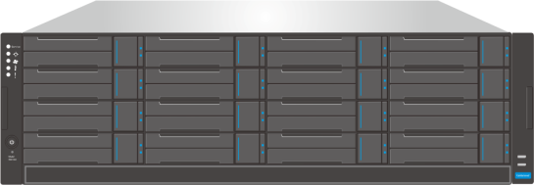
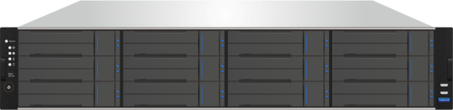
EonServ 5000 Series Front-view
EonServ 5012
EonServ 5016

Slide 11
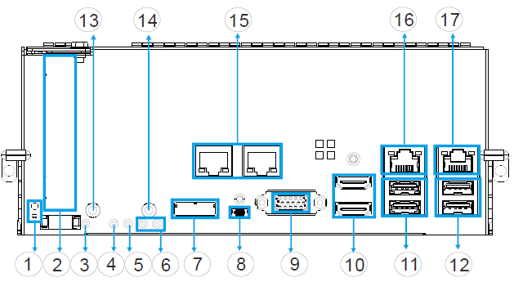
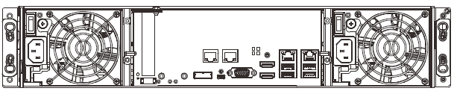
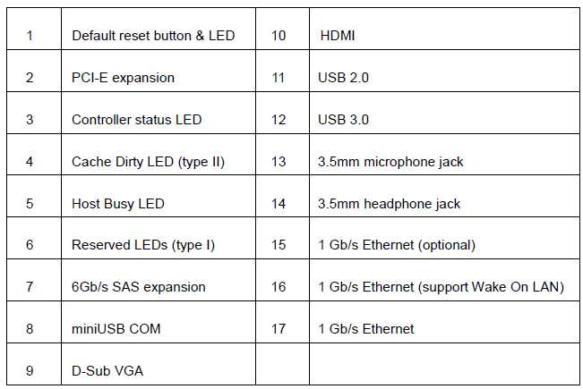
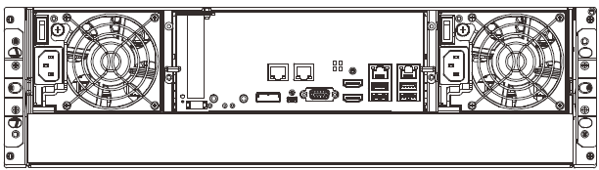
Rear-view & Controller Brief
EonServ 5012
EonServ 5016

Slide 12
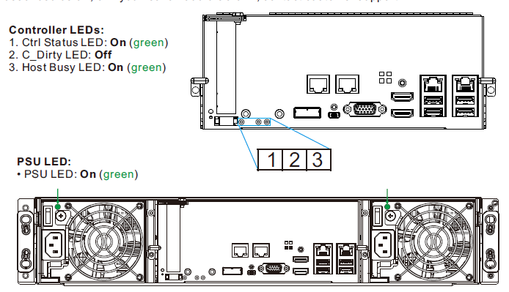
Verifying the Status LEDs

Slide 13
Feature Highlights

Slide 14
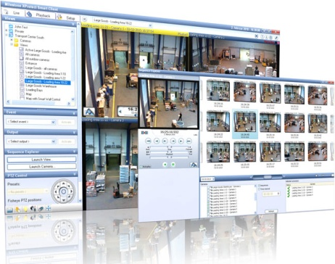
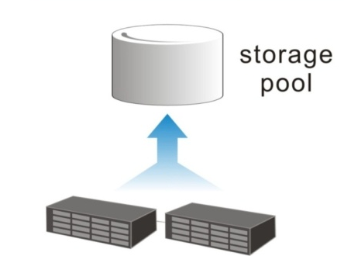

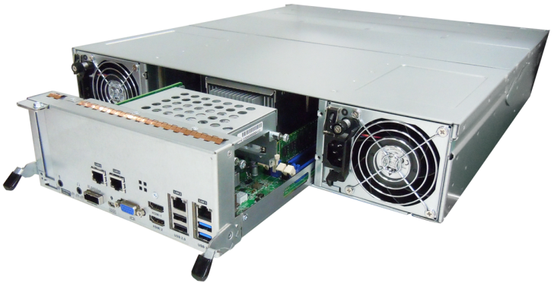
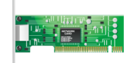
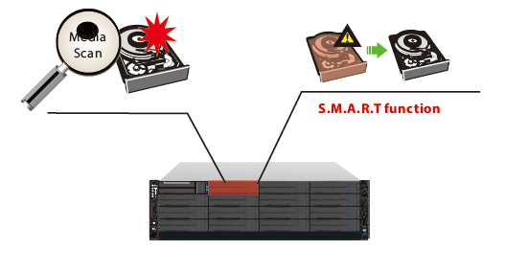
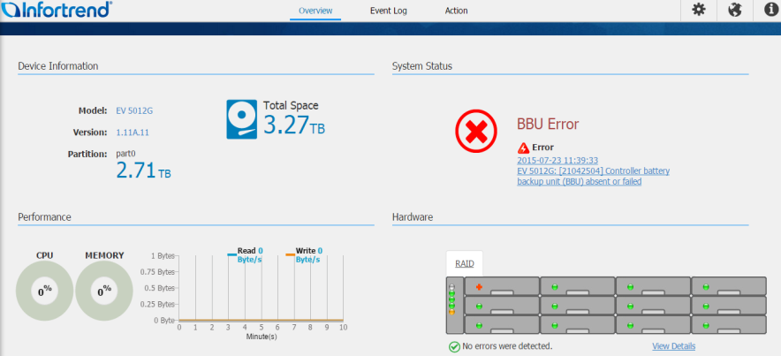
Feature Highlights
1. Server-storage Hybrid Design | 2. Pre-loaded Milestone XProtect | 3. Cableless Design | 4. RAID Platform Virtualization
5. Data Integrity with IDR | 6. Easy to Expand Storage | 7. User-Friendly GUI

Slide 15
1. Server-storage Hybrid Design

Slide 16
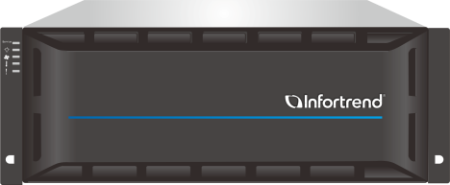
Server-storage Hybrid Design
Highly integrated, low maintenance design
Easy installation without the need to add card or internal cable connection
Simplified server and storage management via single GUI
RAID Storage built-in Server
Server
RAID Card
Legacy Server + RAID card
Infortrend EonServ

Slide 17
2. Pre-installed Milestone XProtect

Slide 18





Milestone XProtect
Pre-installed 2 applications of Milestone XProtect® Software Suite
Supports up to 150-channel 3MP cameras continuous recording without frame drop
XProtect® Corporate
Advanced surveillance solution in large-scale and high-security projects, such as city surveillance and airport.
XProtect® Enterprise
Medium to large surveillance solution for medium-large scale areas, such as train stations and power plants.
145th Camera
Network Video Record(NVR)

Slide 19
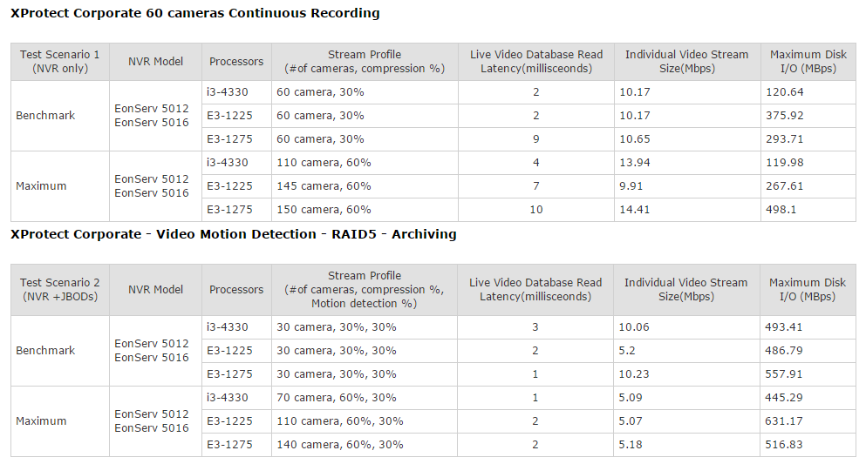
Performance Test

Slide 20
3. Cableless Design

Slide 21
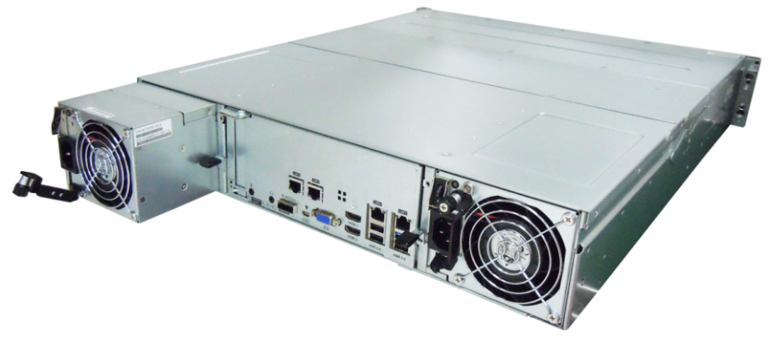
Cableless Design
No internal RAID card cable connection allows for easy deployment
Prevent accidental disconnections or loose cables
Low maintenance modular design
Highly integrated controller that is easy to deploy
Hot-swappable redundant PSU

Slide 22
4. RAID Platform Virtualization

Slide 23
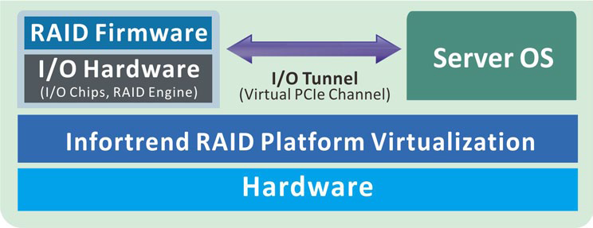
RAID Platform Virtualization
Virtual PCIe channel for RAID F/W and server OS seamless integration
Optimizes both RAID and server components for maximum efficiency

Slide 24
5. Data Integrity with IDR

Slide 25
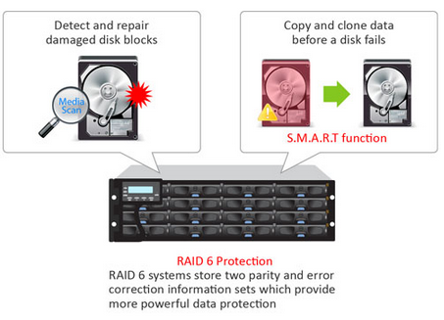
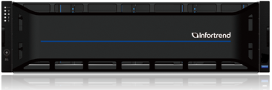
Data Integrity with IDR
Data corruption prevention: smart data recovery mechanism: Detect and recover bad blocks
Drive rebuild prevention: copy and Clone data before a disk fails
with IDR

Slide 26
6. Easy to Expand Storage

Slide 27
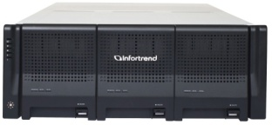

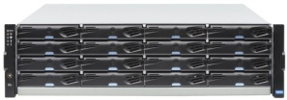
Easy to Expand Storage
Easily expand number of retention days with large capacity
Support up to 316 drives with high density 4U 60-bay expansion enclosure (maximum capacity of up to 2.5 PB with 8TB HDD)
 | JB 212 | JB 216 | JB 260 | Total drives
EonServ 5016 |  | 14 |  | 240
 |  |  | 5 | 316
EonServ 5012 | 14 |  |  | 180
 |  |  | 5 | 312

Slide 28
7. User-Friendly GUI

Slide 29

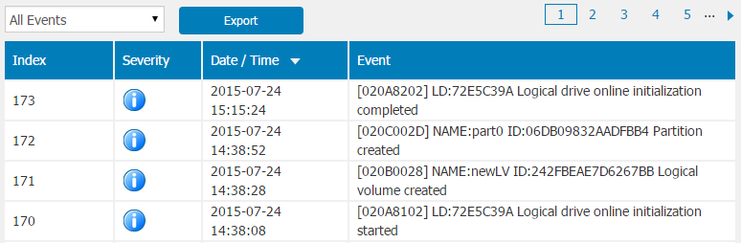
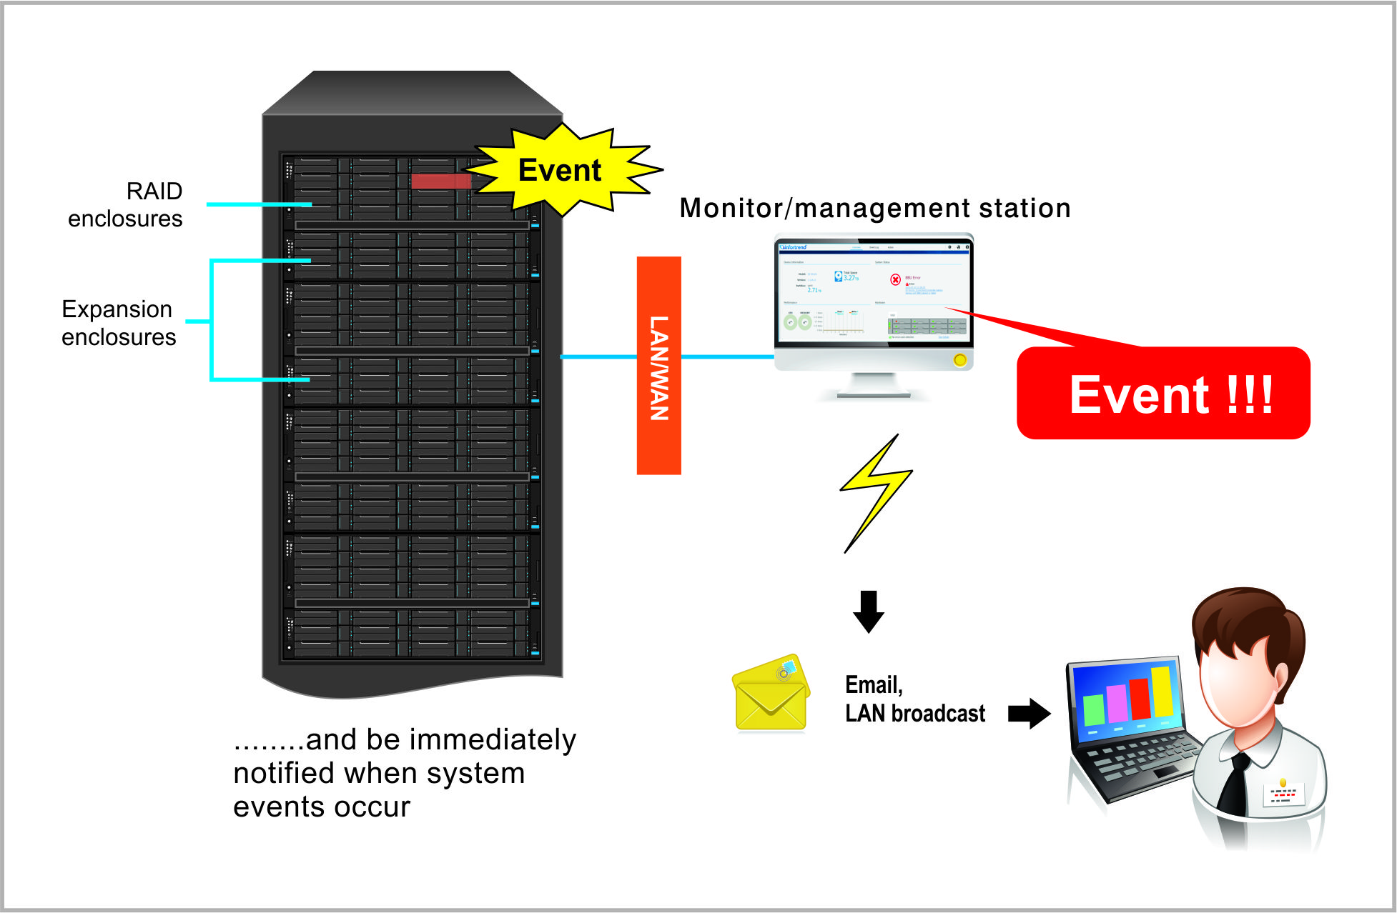
User-Friendly GUI
29
3-step setup
System events checks and notifications
Quick view of storage & server status
Notification mechanism

Slide 30
Sales Tips

Slide 31
Summary
Position : The valued-added NVR for advanced surveillance
Target: Management demand up to 150 channels
Key Values:
Server-storage hybrid design
Pre-loaded Milestone XProtect VMS
Built-in RAID function for data protection
Virtual PCIe channel for RAID F/W and server OS seamless integration
Cableless design with hot swappable redundant component
Built-in SAS expansion for JBODs with up to 316 HDDs
High drives expansion capability provides outstanding scalability and flexibility
Built-in user-friendly GUI – EonOneLite for viewing the status and event notifications
Intuitive set-up page for hassle-free installation

Slide 32





Unique Selling Points
Server-storage Hybrid Design with RAID Protection
Quick Set-up &
User-Friendly GUI
Storage Extension
For Long Hour Recording
Powerful Pre-loaded Milestone XProtect VMS

Slide 33
Ask Surveon
www.surveon.com
sales@surveon.com
Notes:
Web-based Easy System Management Tool

Slide 34

Thank You

